Slide 1
Lung cancer (NSCLC)
2019/9/3

Slide 2
陳妙芬
2014 陳妙芬
Lung CA SBRT的indication tumor size <5 cm, without lymphadenopathy T1, T2, N0M0, medically inoperable, or patient refuse to receive surgery
SBRT定義, 條件?
Lung CA SBRT dose prescription? Peripheral tumor ( 34 Gy/1 fx, 15-20 Gy/3 fractions) or central tumor(< 2cm from proximal brochial tree) (48-50 Gy/4-5 fractions, 60-70/8-10 fractions)
Lung CA SBRT local control 是多少? 80-90%
OAR的dose constraint? 如果是single dose spine < 13 Gy, 3 fractions -> 20 Gy, 食道 30 Gy, heart 34 Gy, great vessel 50 Gy,
central lesion 的SBRT normal organ假如BED用3，要多少以下? Ans ~250(她說沒關係大家都不會)
那個部位的NSCLC標準是先CCRT? superior sulcus tumor
IIIB tx? definitive CCRT, RT dose？ 60 Gy ( by 0617 )
SCLC cT1N0M0的management?可以考慮OP or SBRT if medically inoperable
SCLC limited stage CCRT dose? 45 Gy BID (However, CONVERT also shoewd similar results with 66 Gy QD, but it is a superiority designed trial → standard should be 45 Gy with 1.5 Gy BID )
CCRT在chemo第幾個course給予?--> (1,2間)
PCI role？

Slide 3
2015 簡君儒
貴院一年幾個肺癌病人? 900 -1000 幾個手術? 200-300 幾個做definitive RT? 40-50
肺癌討論會多久一次? 你去過幾次? 個管師名字? 影醫科醫師名字? 病理科醫師名字?
情境: NSCLC, poorly diferrenciated carcinoma, 骨頭單處轉移打過化療x2轉給你，你要做什麼檢查? Chest CT: cT4N0M1b(adrenal gland)，骨頭沒有pathology，PET只有lung有，後來骨頭開刀是fibrous dysplasia...搞不清楚他想表達的重點，應該就是M要pathology
local treatment to the oligal metastatic sites (如果今天影像有懷疑不確定是的話可以考慮biopsy)
印兩張紙上面寫很多小題，覺得自己會的就打勾，我全勾了，從中他抽考，要講evidence。
Unresectable NSCLC治療?
RT劑量? Elective nodal irradiation?
IMRT vs. 3DCRT?

Slide 4
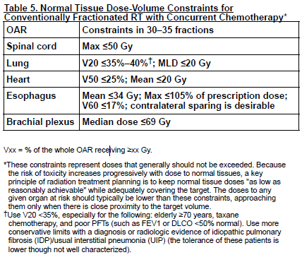
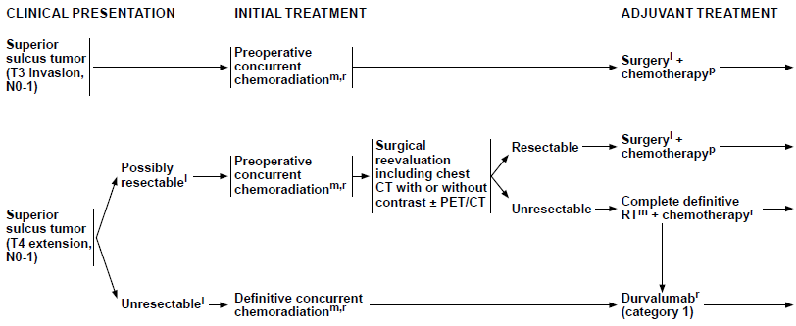
2006
丁禮莉：
Q1: V20於RT alone和CCRT的constraint分別為何？
A: Lung: V20<35%~40%
V20<35% for >70 y/o , taxane, poor PFT
RT along V20<40%, CRT V20<35% (MDACC Lee 2003)
Q2: Mean lung dose (normal lung) 的constraint為何？
A: MLD <20Gy
Q3: 貴科治療lung ca RT alone和CCRT的protocol分別為何？
A: CCRT for unresectable stage III 以上.
RT alone for Stage I-II <5cm, N0, unresctable → SBRT
Stage III: RT alone 可以altered fractionation RTOG 8311 69.6Gy (1.2 BID) improve 3 y/o survival, CHART 54Gy (1.5 TID) vs 60Gy improve 10% absolute survival, severe esophagitis (19%vs3%)
Q4: AJCC stage IIIB定義？T？N？
A: IIIB: T1-2 N3, T3-4 N2
Q5: 何謂superior sulcus cancer? 如何治療？(NCCN準則) 注意事項？
A: Superior sulcus (Pancoast tumor). Tx: SWOG 9416/ INT 0160: Induction CRT 45Gy→ OP → Chemo
Induction 後 如果無法手術 就 完成 CCRT
補充: Chest wall tumor 跟 Superior Sulcus 不一樣: Chest wall tumor 先 OP(preferred)

Slide 5
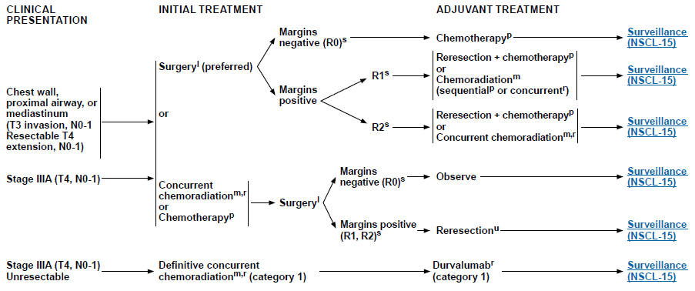

Slide 6
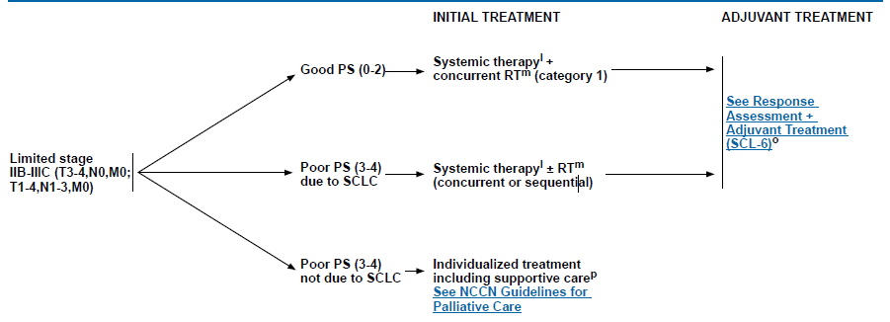
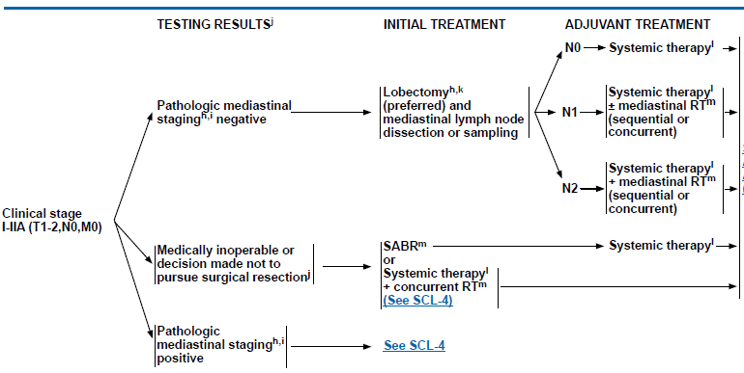
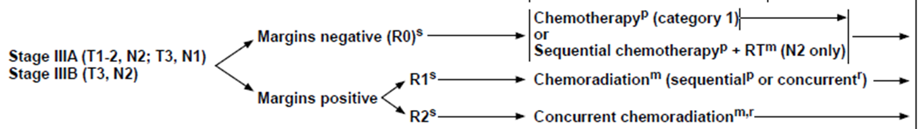
2007
黃經民
Q1: small cell lung cancer limited stage的定義,處置?
分可安全RT與否, 太大 太多顆 就是 Extensive
Q2: RT和chemotherapy的順序,是否同步?
A: CRT better than sequential: (JCOG Takada JCO 2002) 10% OS benefit
Early RT better than late. Increase 5.2% 2 year OS in early RT <9wks. (Meta-analysis Fried JCO 2004)
Poor KPS: Sequential
Q3: Small cell 什麼情況可以OP?
A: Stage IA-IIA,
能手術 就手術 (OP+ MLND),手術後記得 要 CHEMO!
Q4: non-small cell lung cancer—stage IIIA有哪些(TNM), 處置?
A: T4N0, T3-4N1, T1-2 N2
如果是superior sulcus 就 Ind CRT → OP → Chemo
如果是chest wall: OP first preferred. 看一張 PPT
Stage IIIA:
1) Resectable: OP + adj chemo + CRT if (margin+, ECE or N2)
2) If lobectomy planned Ind CRT + OP (INT 0139)
2) Unresectable: CCRT

Slide 7
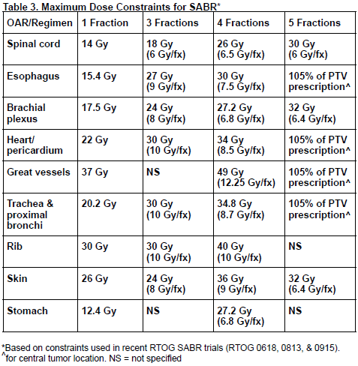
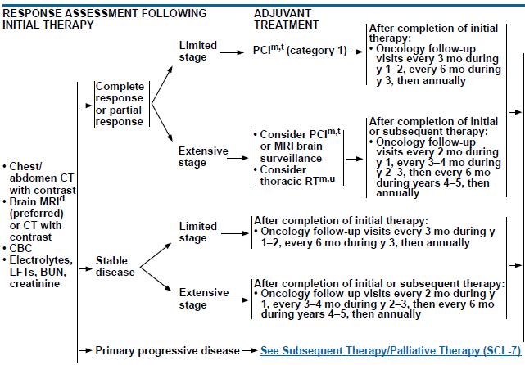
2008
梁雲
Q1: lung cancer RT 範圍怎麼做？
PET/CT delineate, 4D CT, no need for ENI. RT post-chemo tumor, node IFRT (pre-chemo)
4D: no GTV to CTV, ITV = GTV + (MIP), PTV: ITV + 5mm
NSCLC: MSKCC and Yuan ASCO 2007 Only involved area to improve dose escalation (Tumor 接受到的 Dose 比 ENI 重要)
RT alone data: RTOG 9311, 或是 SBRT data in stage I-II: LN failure 都小於 10%
SCLC: CALGB 30610 (45GBID vs 70Gy QD) + Convert 66Gy trial:目前都 no ENI
RT dose : R0N2: 50-54, chemo +Rt
R1, ECE, margin+ : 54-60Gy sequential or CRT
R2: 60Gy CRT
Q2: 哪些重要器官要注意？ lung, heart, spinal cord, esophagus, brachial plexus..]
A: 前面 PPT 有附上 conventional constraint
Q3: Lung 跟bone的correction factor是多少？
Ａ： Lung: 0.25 Bone: 1.65 我不確定是不是問這個
Q4: Whole lung的tolerance dose?
MLD<20Gy
Q5: PCI什麼時候要做？怎麼做？劑量？
NSCLC: RTOG 0214 PCI no OS
SCLC: RTOG 0212, EORTC (Slotman) → PCI improve OS and decrease brain mets 25Gy/10fx or 20Gy/5fx
NCCN: 不管limited or extensive有 complete response 或是 partial response 病人 就做PCI. 手術 後也做 ( 但針對 這點 NCCN surgery 部分說stage I-IIA 病人少見 brain mets 可不做
病人如果大於60歲toxicity increase, discuss with patient.
Poor performance or cognitive impair → no PCI

Slide 8
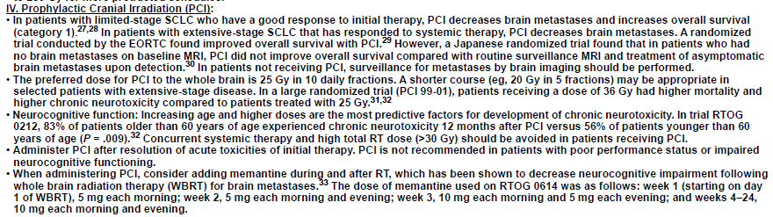

Slide 9


2009
和信鄭鴻鈞主任
Q1: Low dose CT 在lung Ca staging screening的角色？
A: NLST 每 screen 320 LDCT 可以prevent 1 death. LDCT decrease RR by 20%. USPSTF: 55-80y/o greater than 30PPY and smokers who quit <15 year
Q2: 做low dose CT screening可能對病人造成什麼危險？
A: 增加不必要的invasive procedure (因為screening出來有很多小的lung mass或benign tumor會因為這樣需要做invasive Bx)
Q3: 一個病人RLL T2N1, LUL有一顆<3cm nodule, staging?
A: 兩個primary, T2N1及 left T1cN0, 都可以分別手術, 病人可能可以治癒,
Q4: 如果RLL T3N1, WBBS negative 但是PET發現在L4的地方有uptake, 接下來怎麼做?
A: PET的sensitivity約85-90%???(我的書寫７０% sensitivity, specificity 90%), 所以還是應該要做tissue proof, 才能得到正確的staging. M0和M1的差別會影響治療。
M1 molecular testing, Target therapy
Q5: T1-2N0M0的lung Ca，operable，請問你病人需不需要做PET？理由是什麼？
A: NCCN guideline 從 IA workup 就有 PET/CT, 建議做. occult mets : 6~18%, PET/CT false positive 10~20%
Q6: Locally advanced inoperable lung Ca需不需要做PET？理由是什麼？ Lung cancer work-up, PET的角色?
A: 主要就是看是不是N2, 另外就是可幫助RT contour. Lung Ca RT 走involved field, not ENI. PET可以幫助target volume delineation
Q7: 如果PET在mediastinum有顯影, 接下來怎麼做?
A: Mediastinoscope拿組織確認
Q8: Case: 一病患，右下肺有一5 cm腫瘤，確定為adenocarcinoma，同側hilar lymph node PET positive，另有一 nodule左上肺Apex，PET avid…試問病人應如何處置？回答應Bx因為PET會false positive，而病人的disease除了那一顆以外是operable disease，應該aggressive. 主任再問Bx出來如果也是adenocarcinoma應如何處理？主任說應考慮2nd primary lung Ca的可能。
A: 不知道前面在說甚麼 anyway 我自己會選擇 Treat as two primary A: Multiple Lung, N0-1 能開則開
A: N2-N3, Advanced or Metastatic, → Molecular testing

Slide 10
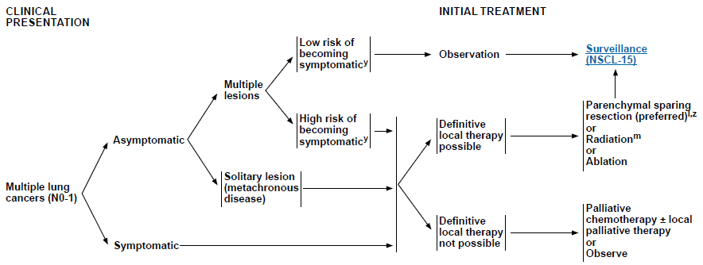
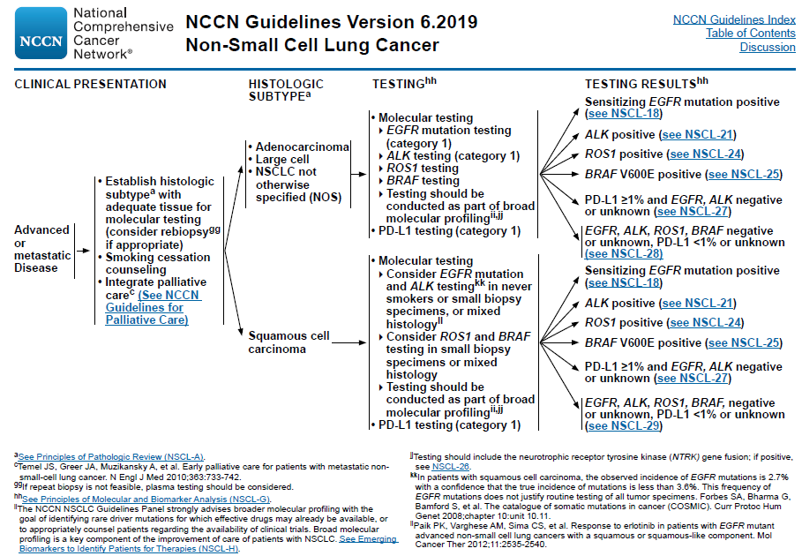

Slide 11
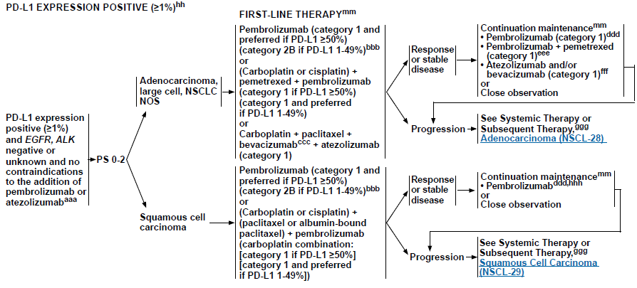
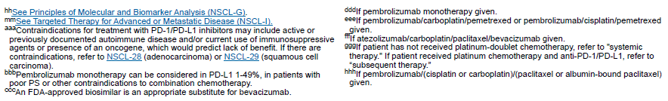

Slide 12
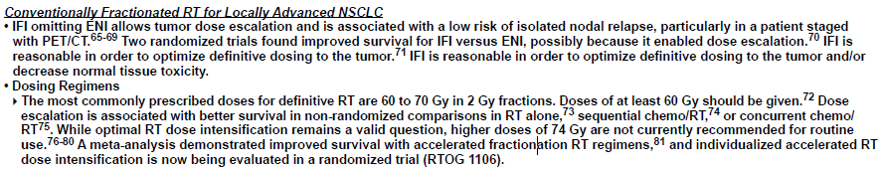
2009 continue
Q9: Target therapy (如Erbitux) 在K-ras wild-type及EGFR overexpression才有用?
A:對於K-ras gene對於lung CA預後的影響…(K-ras(+)就不能使用EGFR…)
A: KRAS mutation resistant to EGFR TKI
Q10. Pre-op CCRT之後V20的dose constraint應該怎麼設定，為什麼要設定V20 <= 20%
A: 我的答案Pre-OP CCRT 一開始要嚴， 萬一無法開刀可以繼續ＣＣＲＴ好像（好像有trial可以看要再查一下)
Ｑ11: Pre-op CCRT做完以後病人不應該接受那一種手術
A: INT 0139: 26% died in pneumonectomy, 1% lobectomy
German Lung Cooperative Group (Pre-OP Chemo vs Per-OP CRT Lancet Thomas 2008) 增加 Mortality in CRT group
Q 12: Inoperable locally advanced lung Ca放射治療照射的範圍，劑量，以及照法，採取ENI的主要理由？

Slide 13
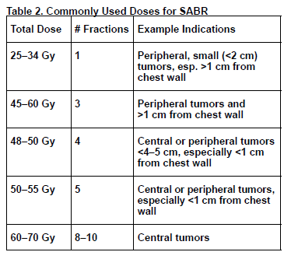
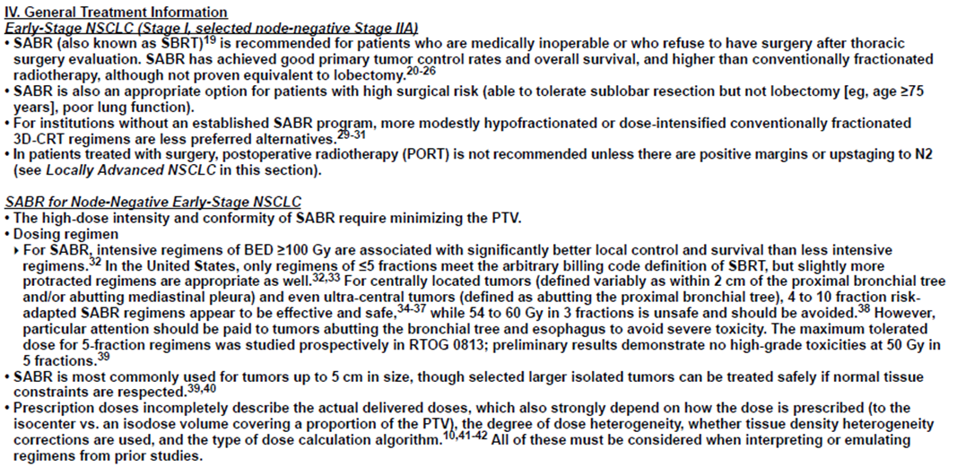
2009
Q13: 請問SBRT在Lung CA的角色 ?
For inoperable, high risk (>75 age or poor PFT)
BED > 100 Gy10; > 80 Gy10的volume要盡量減少
Centrally located <2cm from bronchial tree, 4~10 fx
RTOG 0813 centrally located (9-11Gy x 5 no toxicity, 12Gy 1patient有發生）

Slide 14

NCCN
Incidental nodule→
第一步 評估 病人 : age, smoking hx, cancer hx family hx, work, COPD, TB
評估 影像: size shape density, inflammation, scarring
Low dose CT→
Low risk:
High risk:
Smoker, family hx, exposure: asbestos, radon, uranium
<6mm: OBS or follow CT 12mo if high risk
6-12mm: CT @ 6-12mo
8mm: CT @ 3mo, PET, or biopsy

Slide 15
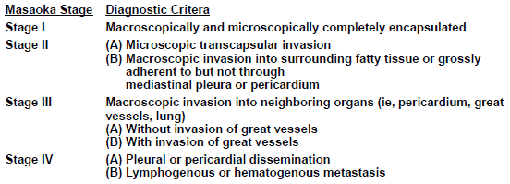
2010
梁基安
Q1: NSCLC 的 dose
A: Pre-OP 45Gy, CRT: 60Gy, Post-OP R0: 50-54 , R1R2 54-60Gy
Q2: SCLC 的RT：CRT, early better than late, CRT : 45Gy BID (INT 0096) or 66Gy QD (Convert) , Consolidative : 30Gy/10fx (Crest Slotman)
Q3: SBRT 在 lung cancer: 前面以回答
Q4: Thymoma stage是?? 背全部Masaoka
Q5: Anterior mediastiastinal tumor常見tumor，如何approach，如何DD (image, lab)
A: Anterimor 3T1L: thymoma., teratoma, thyroid, lymphoma
A: HL: B symptoms, Nodular sclerosing classic HL 70% most common in mediastimum.
NHL: LDH elevated
Tertoma: fat and cystic component
Germ cell: elevated B-HCG, AFP
35-50% thmoma has MG, 10~15% MG has thymoma
Thymoma symptom: stridor. Chest pain, phrenic nerve palsy. MG. SCV syndrome

Slide 16

2011
顏上惠主任
Q1.台灣一年有多少位lung cancer病人，男女比是多少?其中adenocarcinoma所佔的比例?
A: 約13000人~14000，男女比1.6 :1, adeno 約6成，男佔5成女佔8成
Q2. Non-small cell lung cancer T1, T2如何治療?何時需要使用到RT? 問NSCL stage I-II何時作adjuvant Tx
A: 術前看mediastinal LN (-) : Surgery, if inoperable -> SBRT
A: adjuvant Tx(IB以上C/T, N2, margin +→post-OP R/T)
Q3. Stage I的病人如果不開刀的話，病人有何治療選擇?
A: SBRT
Q4. Stage II的病人，要選擇甚麼樣的治療方式?
A: CCRT, sequential RT or RT alon. 當然如果是N- stage II有部分病人可以考慮做SBRT
果手術後發現有N1，需不需要做RT?
A: 不用, adjuvant chemotherapy for N+ : LACE (Pignon) increase 5 % overall survival
Q5. Stage III的病人要怎麼要去治療，治療的劑量要給多少?RT有沒有需要elective nodal irradiation? Evidence?
A: CCRT, 但是如果是resectable stage III可以做 pre-op chemo或post-op RT. No ENI Evidence MSKCC (Rosenzweig 2007 JCO) (Yuan ASCO 2007 phase III better LC with IFRT vs ENI
Q6. NSCLC的dose escalation有沒有evidence?
RTOG0617 for stage IIIA-B NSCLC dose escalation 沒好處

Slide 17
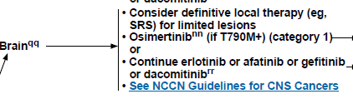
2011 continue
Q7: SCLC limited stage要怎麼去治療? SCLC limited, R/T role
A: stage i-IIA: OP + MLND , limited can’t OP: CRT, sequential if poor PFS
A: 根據JCOG Takada 2002 JCO : CCRT比sequential ChemoRT好, 30vs 20% 10% OS benefit
Metanalysis Fried JCO 2004 <9 weeks vs 9 weeks after chemo, 5.5% better 2 year OS with early RT.
RT開始的時機為第一次到第二次化療之間。治療期間的長短會影響存活率。
Q8: →SCLC limited CCRT做完之後要做什麼?
A: 如果是responder可以做PCI來降低腦部轉移的機率與存活率
Q9:PCI 2.5 x 10 Gy你覺得late toxicity? 要加更高嗎
A: PCI會造成病人的神經認知功能下降，根據RTOG0212的結果，對於超過60歲的病人PCI治療後1年的神經認知功能高達8成，但小於60歲有問題的約6成，PCI超過30Gy也會傷害神經認知功能。所以劑量2500cGy/10Fx就足夠了。 36Gy greater motrality,
Extensive stage: Slotman 2007 Eortc 08993 PCI increased OS but Japan negative staging brain MRI, PCI no improvement of OS for PCI
Q10: NSCLC有2-3 顆brian mets,如何處理?
A: 如果身體狀況許可就SBRT or Surgery
A: or 區分是non-SCC (adeno/large cell)或SCC，
若是 adeno/large cell，要驗 EGFR mutation 及 ALK testing
EGFR 有mutation ➔ brain progression→ Osimertinib (categorgy1)
Q11: PCI在non-small cell lung cancer的角色為何?
A: no survival benefit, RTOG 0214

Slide 18
2011 Continue
Q12: 現在醫療技術進步，如果病人腦部有轉移，那病人要去選擇手術或者放射治療?這是curative還是palliative intent?
A: OP if single lesion amenable to resection, controlled or absent extracranial disease, KPS> 70, age <60, life expectancy >2 mo, secondary to mass effect emergent relief, need tissue Dx. A: SRS: patients ≤50 years of age, SRS alone favored survival, in addition, the initial omission of WBRT did not impact distant brain relapse rates. SRS alone may be the preferred treatment for this age group. (Saghal metaanalysis Red journal 2015)
Q 13. 治療前有哪些驗證工具?
A: 4DCT, PET/Simulation, IMRT/VMAT, IGRT, motion management , EPID ,Cone Beam
Q14: 肺癌的哪些病人適合用VMAT ? 那些病人適合使用SBRT ?
A: <5cm, peripheral, N0 unresectable, unsuitable for surgery >75 poor PFT
Q15; 那一些化療藥物不適合與RT併用在肺癌治療(除了Gemzar以外)?
A: Target Therapy???

Slide 19
2011
Q16: Thymoma有哪些RT治療的indication?
A: Stage II證據不是很夠, stage III以上就很適合，也講了NCCN stage II以上建議都做，還有margin(+)也建議做 R2: CT+ RT
A: Adj RT: AJCC stage II-III (Mastsoka III), R1 resection, or any thymic carcinoma
1) Meta-analysis Korst 2009: no benefit of LR in PORT for stage aII-III
2) JART Omasa 2015: for Mastsoka II-III no RFS or OS, for Stage II-III better RFS no OS
3) NCDB Jackson 2017: PORT improved OS in Masaoka stage IIB or positive margin R1 or R2
Adj chemo in R2 for thymoma, in R1 and R2 for thymic carcinoma
R0: 45-54Gy, R1 55-60Gy R2: 60-70Gy
Chemo: CAP+ steroid, VIP,
Q17: Methothelioma要如何去治療?病人是curative還是palliative intent?
A: Stage I-III resectable: 1. EPP or P/D → chemo → hemithroax radiation
2: Neoadj chemo → EPP or P/D → hemi RT 45-54Gy
A: Palliative or curative I don’t know. 基本上活不過2年, low risk 1 year 40%, high risk: 12 %
Q18: RT要注意什麼organ…有裝pace maker的怎麼辦…就講說我以前看paper好像影響不會太大, 只是要避開field, 最後主任揭曉答案, RT因為電磁波可能會干擾到, 但若不在field內, 影響沒那麼大, 最後說那要怎麼降低risk及現場處理, 我就說要放DC shock, 主任說: 要refer給心臟科啊…
Q19: NSCLC的dose escalation有沒有evidence?
A: RTOG 9311 90.3GY too toxic, RTOG 7301: 40 vs 50 vs 60, 60 Gy became standard, Altered Fx RTOG 8311: 69.6Gy BID
A; RTOG 1106 ongoing crt 60Gy vs 66-80.4Gy CRT dose escalation

Slide 20
2012 許文林
Q: NSCLC什麼時候會建議使用RT?
A: Unresectable early stage, Resectable margin + ENE, N2,
Q: Lung CA brain meta 三顆怎麼處理?
A: Molecular test first if EGFR or ALK , use osimertinib (FLAURA trial) Alectinib (AEEX trial) , reserve RT if symptom, 3 顆 小於 3 cm, 可 SRS, or SRS+ WBRT, or molecular test first (我覺得應該要給local treatment )- > 根據SABR COMET, 可以增加overall survival
Q: Lung cancer SRS的給法
A: NCCN guidline

Slide 21
Q: 呼吸gating的方式有哪些 (active breathing control and passive breathing gating)
A: 4DCT with belt, Tracking: Brainlab Exactrac,
A: Respiratory gating (a) phase gating: beam on when respirator signal within gating window defined by respiratory signal
(b) amplitude gating: beam on when respiratory signal is within gating window defined based on amplitude/ discplacement of respiratory signal
ANZAI repiratory gating system (measuring abdominal pressure), Varian RPM, Vision RT, (measuring chest wall motion by optic system with infrared camera or laser surface imaging) Elekta ABC system (measuring the inspiration and expireation air volume using spirometry or temperature change)
Q: 若要選擇吸氣或是吐氣的phase進行治療你會選哪一個？原因是什麼？
A: 吸氣，lung volume較大 ( but 不穩定度比較高)
Q:IMRT好 還是3D 好?
A: IMRT similar local control and 2 year survival but lower rates of pneumonitis and cardia dose ( Chun JCO 2017)
Q: Normal tissue constraint 正常組織受傷最大的是什麼? A: lung ????heart??

Slide 22
2012
Q: 請問2009年台灣統計一年有幾個lung cancer被診斷、一年有幾個patients因為lung cancer死亡?
A; 2016: 14000/ year, 9000 death/year
Q: Lung cancer的risk factor?
A: smoker, family history. Abesto, radon, uranium exposure, living with second hand increase 20~30% risk
Q; 和abestos最相關的惡性腫瘤?
A: mesothelioma, 10% lifetime risk of Mesothelioma, latency20-40 years later
Q: Lung cancer做definitive RT的target volume? 照也會考慮如何安排?
A: PET/CT delineate, IFRT, no ENI, post chemo tumor volume, pre-chemo nodal involve field
Q: 貴院是否有SBRT的經驗? 試述對lung cancer做SBRT的所知所聞，包括療效和副作用? 常見的副作用 : chest wll pain, dyspnea
Q: 如何解決lung cancer病人接受RT時organ motion的問題? 壓腹限制呼吸, 或是active breathing control(訓練病人的呼吸幅度,吸氣閉氣)並用vision RT 等監測、或是呼吸的gating (偵測呼吸的phase or amplititude), 以及可以tumor放fisidual marker 做監測
A: abdominal compression

Slide 23
2013
<Lung>
Lung-呂志得
Q1: 83歲男性病人，在外面身體檢查CxR發現右上肺葉有一個2公分nodule，拿著影像來向你諮詢及如何處置。從病人的history taking開始，包括present illness、past history、family history、life behavior等等先問起，要先從良性疾病排除起。接著才考慮biopsy，結果adenocarcinoma，問後續檢查。
A: CT, PET, brain MRI if > stage II
Q2: chest CT發現左下肺葉有兩個小小的nodule，問後續
我答由於前面已知為NSCLC所以除了chest CT，我會同步安排PET，結果只發現左邊hilar一個亮點，但LLL的沒有亮，問我的判斷結果。 → primary tumor LN mets(N3) or second primary? Left hilar也安排bronchoscopic biopsy → adenocarcinoma 若scope看不到就用VATS
Q3: 呂主任說那就把他當作T1N3好了，問治療?
T1N3 stage IIIB, unresectable CRT, (考量病人年齡可以考慮 sequential chemo-RT or RT alone)。
4. 那病人若是Lt Hilar 那顆亮點只是一個 inflammation / infection 造成的，變成T1N0，年齡較大堅持不想手術，有沒有其他方法?
A: SABR 請背出 RTOG 0236的作法與結果與副作用。
RTOG 0236 Timmerman 60Gy/3fx, inoperable >2cm from bronchial tree, 5y LC : 93% 5year: OS40%
16.3% grade 3-4 toxicity no grade 5

Slide 24
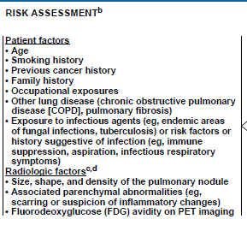
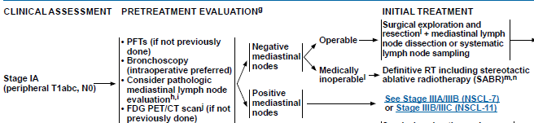
2014[梁雲]
Q: 病人拿X光片說右下肺葉有個兩公分nodule, 後續處理與如何評估?
A: (他要你回答問history, history很重要!! TB & smoking),
Q: Lung SqCC與AdenoCA的影像特性有何不同? (中央 squamous/周邊peripheral)
Q: Nsclc RT dose ？ 老題目
A: Pre-op :45-54Gy ; Post-op : 50-54Gy ; definitive : 60-70Gy
Q: SCLC何時該照RT? If Post –OP: N1 N2 CRT, if poor response sequential
A: limited stage 配合化療做CCRT, extensive stage放療的腳色是consolidative tx, 還有就是PCI，如果一開始治療有反應，就可以加上PCI來降低腦部轉移的機會。
Q: 何時照PCI? 劑量? CR or pR or post –OP, 25Gy/10fx
Q: SBRT的機器有哪些條件? (immobilization, IGRT, 呼吸調控, leaf寬度...等等)
Q: Lung CA照SBRT的indication?
A: T1, early T2.

Slide 25
2014
Thymoma 和thymic carcinoma臨床表現之差別?
A: Thymic carcinoma rare <1% thymic tumor, very aggressive, not associated with paraneoplastic sndrom (MG), do not have immature T lymphomcyte. Lack lobulated pattien. Lack Hassall corpuscles, medullary differentiation and perivascular space. Type C
Thymic carcinoma 比較容易transcapsular extension, 容易有lymph node metastases 及distant metastases
Q: RT pneumonitis Gr III? lung constraint? lung V20< ??
RTOG G3 pneumonitis : severe cough unresponsive to nacrotic antitussive agents or dyspanea at rest, radiologic evidence of pneumonitis, oxygen/steroid use Gr 4 intubate Gr5; death
Lung constraint : Lung v20<35Gy, v5<65Gy, MLD<20Gy
SBRT dose? normal organ dose constraint? (BED>100)
A: refer to NCCN
Q: Hippocampus sparing WBRT的經驗?
A: RTOG 0933 decline in HVLT-R significantly lower , no decline in QoL

Slide 26

2014 陳妙芬
Q: Lung CA SBRT的indication, SBRT定義, 條件? Lung CA SBRT dose prescription? 有提到RTOG 0236
A: NCCN, tumor < 5 cm, inoperable , old age poor PFT
Q: Lung CA SBRT local control 是多少?
A: 3 year LC for stage I lung cancer patient range from 85~95%, 3 yr OS 55%-91%
Q: OAR的dose constraint?
A: refer to NCCN
Q: central lesion 的SBRT normal organ假如BED用3，要多少以下?
A: : ~250(她說沒關係大家都不會)???
A: My answer: 180-210Gy associated with grade 3 pulmonary complication, Keep BED>100Gy sufficient for LC
Q: 那個部位的NSCLC標準是先CCRT?
A: superior sulcus tumor
Q: IIIB tx? definitive CCRT, RT dose？
A: CRT, 60-70Gy definite, @D Era: RTOG 7301 established standard 60Gy, RTOG 0617: 60Gy CRT better than 74Gy, altered fx: >69.6 BID RTOG 8311, 60Gy with CRT, RTOG 1106 testing 60Gy vs dose escalation to 66-80.4Gy Q: SC提LC cT1N0M0的management?
A: stage I-IIA OP+MLND → chemotherapy
SCLC limited stage CCRT dose?
A: 45Gy bid or 66GyQD
Q: CCRT在chemo第幾個course給予?--> (1,2間)
A: cisplatin and etoposide with early RT during cycle 1 or 2
Q: PCI role？
A: post –OP patients, CR or PR patients, omit in poor KPS or poor cognition, discuss with patient with >60y/o due to neurotoxicity RTOG 0212

Slide 27
Q: soft tissue sarcoma pre-OP的 CTV和PTV如何定義? dose?
A: Traditionally: GTV + 4~5cm =CTV , CTV+1cm =PTV, radial 1.5~2cm
Sugery 3-6 wks after pre-op RT, Dose :50Gy/25fx
RTOG 0630:
GTV = MRI T1 with contrast
CTV (Grade2-3 >8cm), GTV+3cm , 1.5 radial
CTV (Grade 1 or Gr2-3< 8cm) GTV +2cm , 1 cm radial
PTV=CTV+0.5cm
Results: late grade 2 toxicity sign improved, LC 94% recurrence in field
Q: post-OP的話呢? post-op 的indication為和?
10-20 days after surgery, 3 -8 wks
50Gy post op bed :GTV+ 4~5cm radial 2cm, PTV: 0.5~1cm +Boost 16Gy to GTV+2cm
Q: MAltoma RT劑量?
Q: 30Gy
Q: DLBCL RT劑量
A: 30-36Gy

Slide 28
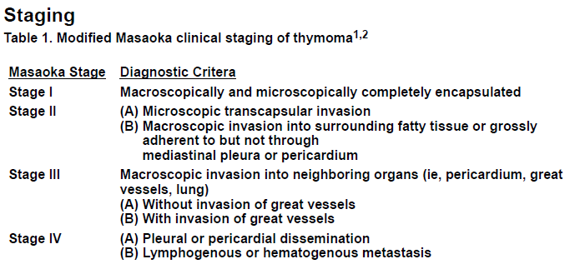
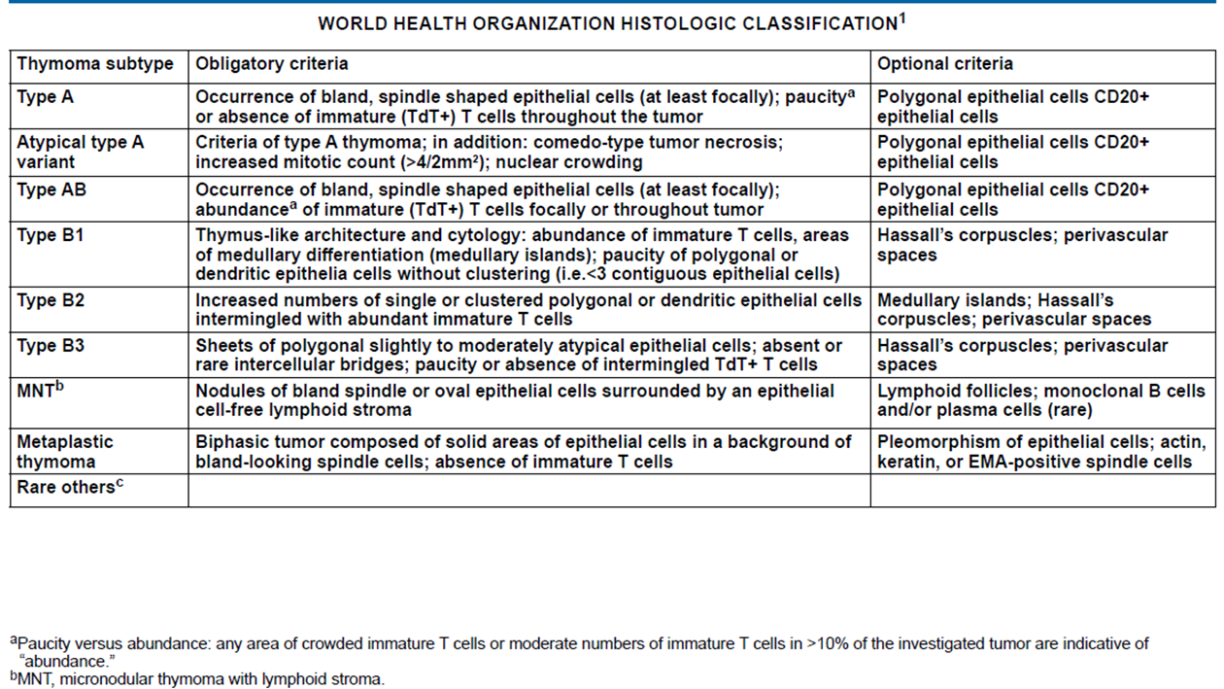
2014
Q: Thymoma stage system，WHO grading、 若病人開完刀病理診斷為WHO type B thymoma，請問你arrange 的RT範圍 ?劑量?
Q: WHO A, AB, B1 lower risk 90% long term survival
RT: entire bed of resection . R0: 45-50Gy, R1: 54Gy-60 R2: 60-70Gy
Q: 有多少thymoma會有MG?
A: 35-%50%
Q: 多少MG有thymoma?
A: 15%
Q: Thymoma治療後MG是否改善?
A: Yes

Slide 29
2015
Q: 直接問你你們醫院有多少肺癌病人，initial OP有多少，initial definitive RT有多少，有沒有團隊，多久開一次會，個管師名字，有沒有病理科醫師/名字，有沒有影像科醫師/名字，你去過幾次。
A: 不知道， 隨便說
Q: 有一位病人，LUL Ca (NSCLC; EGFR: WT)，adrenal meta，s/p C/T x 2, in PR, with femur meta，for local RT。接下來你認為還有什麼資訊你不清楚的，或者必須知道記載在病歷上面，還有要怎麼治療，看你如何回答，且針對相關想知道東西的發問。
A: Chest CT: cT4N0M1b(adrenal gland)，骨頭沒有pathology，PET只有lung有，後來骨頭開刀是fibrous dysplasia...搞不清楚他想表達的重點，應該就是M要pathology（蛤，我遇到的不同，他說femoral bone lesion PET有uptake，我說要安排biopsy，他就酸酸的說你們科可以自己biopsy噢，外科說不適合biopsy耶）
Ａ：病人來是因為hoarseness不會咳喘，我說要安排CT / PET/CT等影像survey有沒有mediastinal lymph node壓到recurrent laryngeal nerve並要安排bronchoscopy檢查，我還沒講完他就打斷說mediastinum沒有node，你排bronchoscopey要看什麼？然後說病人是左上肺葉腫瘤，我就問影像上是否為superior sulcus tumor，有沒有Horner sign手麻手無力肩膀痛，他說都沒有
Q: IMRT vs. 3DCRT?
A: (有沒有evidence, 哪一篇? 誰知壓，唬爛一下有MDACC retrospective series，反正很多病都嘛有MDACC retrospective series，可以降低heart, lung, esophagus dose….
Q. 拿一張紙，上面寫了許多選項，要你自己勾你有信心的地方，針對那些地方問你。主要設定在有一位stage III的NSCLC的病人，不能開刀，你的建議有哪些治療方法，這些治療方法後面有沒有哪些研究支持你，請舉出來。

Slide 30
2016
Q2. Thymoma: (Masaoka staging system)
I: completely encapsulated
II: 穿過capsule (IIA: micro; IIB: macro)
III: 侵犯鄰近器官 (IIIA:非大血管; IIIB:大血管)
IVA: Pleural or pericardial dissemination IV; IVB: Lymphatic or hematogenous metastasis
Q: 若有mediastinal LAP 算Masaoka stage 幾?
A: stage IVB (Masoka), AJCC M1a/N1 IVA, M1b/N2: IVB
A: unresectable, chemo → RT or OP , MDACC chemo platinum based CAP→ max OP → PORT 7 y follow 100% OS
Q: Treatment: op 為主，R/T dose?
A: R0 45-54, R1: 54-60 R2 : 60-70
A: 放射治療劑量: R0 resection 45-50 Gy, R1 resection 54 Gy, R2 resection 60 Gy, definitive 60-70 Gy ( 一次的fraction size 1.8-2 Gy)
Q:不同期別 要如何治療？
A: 參考NCCN guideline, 如果可以開刀就做surgical resection 之後
stage I R0 resection -> observation,
stage II-IV -> post-operative RT.
R1 resection→ post-OP RT(+chemo if thymic carcinoma).
R2 resection→ RT+ chemo
若unresectable disease : CCRT , potentially resectable : 先induction chemotherapy 再手術
Q: 最常用的化療是CAP (cyclophosphamide, adriamycin, cisplatin)
A: Thymoma → CAP ( cyclophosphamide + doxorubicin + cisplatin ) ,
thymic carcinoma → paclitaxel + carboplatin

Slide 31
Q3: Pancoast tumor = apical tumor (superior sulcus tumor) + either chest wall (rib) invasion or Pancoast syndrome {triad: shoulder pain/brachial plexus palsy, hoarseness and Horner’s syndrome (ptosis, meiosis, and ipsilateral anhidrosis)}
A: T3起跳
A: Tx: Pre-op CCRT → OP + post-op C/T
If unresectable → definite CCRT + C/T
Q 4. NSCLC stage IIIB (N3)的治療?
A: CCRT
Q 5. NSCLC stage IIIA (N2)的治療?
A: CCRT or induction CRT if lobectomy planned
A: Pre-op C/T + OP (EORTC 04891) or pre-op CCRT + OP (INT-0139) or definite CCRT (RTOG-9410)

Slide 32
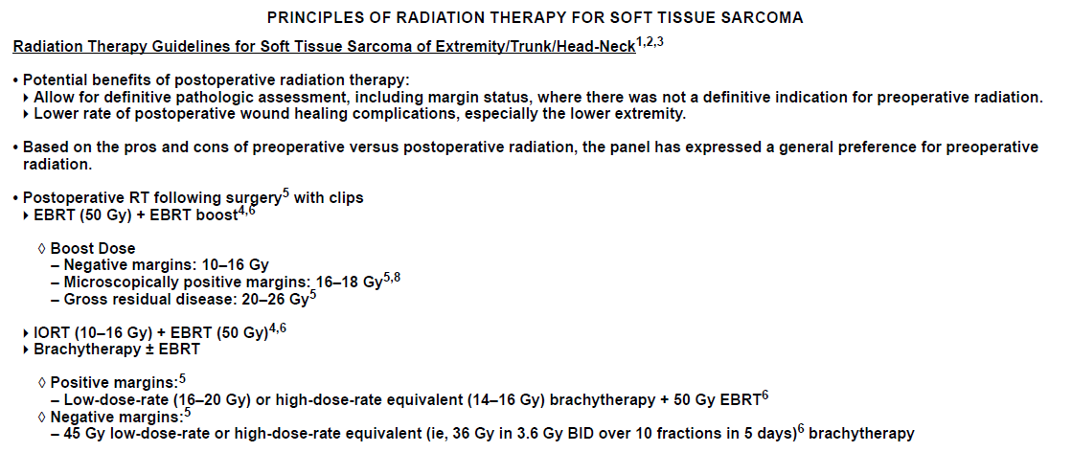
Lung/Mediastinum/Soft tissue 成大 陳海雯
Soft tissue sarcoma:
Q: 好發部位: Lower extremity (45%) > trunk (30%) > upper extremity (15%) > H&N (8%)
發生頻率: Malignant fibrous histiocytoma (20-30%), liposarcoma (10-20%), leiomyosarcoma (10-15%)
Q: R0, R1, R2 resection 的 R/T dose???
R1: 16-18Gy boost R2: 20-26Gy boost

Slide 33
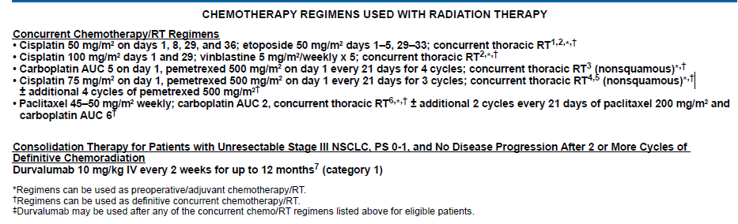
2016
Lung 亞東 吳樂榮
1. SRS indication?
Ａ： T1-2, ≤ 5cm, tumor inoperable or too much comobidities to receive general anesthesia or operation
A:有提到在SBRT不能直接拿LQ model的BED公式去算，老師說答得好！
q: peripheral/central tumor的常用劑量?
A: peripheral 34Gy/1, 60Gy/3fx, central : 48-50/4fx, 50-55 /5fx, 60-70/8-10fx
2. Right lung Ca s/p op會拿哪些LNs group?
A: 講一下mediastinal 大概的位置，記得沒有group 1; group 3拿不到; 因為是右邊的腫瘤，所以左邊的group 5 (AP window)和group 6 (Para-aortic)應該不會拿 → 所以至少拿 group 2, 4, 7, 10 (8, 9比較下面，看腫瘤位置，11-14在lobe裡，也不用特別拿)
Ａ：看圖 Ｒight 2,4, 7 10,
3. Lung SCC and Adenocarcinoma 的化療?
A: CP, PP, PE: carboplat, cisplatin premetrexed, cisplatin and etoposide, (premetrexed for non-SCC)
A: Jama 2017 CP vs PE + RT, no difference , PE higher grade 3-4 heme tox
Proclaim trial PP vs PE: PP less grade 3-4 tox neutropenia
4. SCLC limited stage vs extensive stage ?
A: old question,refer to previous slides
5. SCLC PCI indication?
A: Patient s/p C/T with CR or PR should receive PCI (25Gy/10Fx)
6. SCLC C/T regimen?
Q: Cisplatin + Etoposide

Slide 34
問tumor會因為呼吸移動多少?在哪個位置移動比較多還是都一樣?除了respiratory gating還有什方法解位移? ABC的全名是什麼?知不知道ABC怎麼做
Q: respiration gating: phase gating or amplitude gating
ABC: active breathing control

Slide 35
2016
Q: PORT indication:
A: Margin, N2.
Q: 肺癌Definitive CCRT的時候RT劑量多少？能不能做到74Gy? evidence? chemo agent是甚麼？不同histology chemotherapy不同?有問會用Alimta的病人是哪一種histology?
A: RTOG 0617 60gy CRT , 70Gy detrimental to OS
A: Almita is Premetrexed for Non-Squamous,
Q: SCLC何謂Limited stage. SCLC做PCI的時機? 要CR做還是PR也可以做？劑量為何？
A: old question NCCN CR and PR just PCI !
Limited Disease:
a) Disease confined to one hemithorax, although local extensions may be present;
b) No extrathoracic metastases except for possible ipsilateral supraclavicular nodes if they can be included in the same portal as the primary tumor;
(c) Primary tumor and regional nodes which can be adequatly treated and totally encompassed in every portal.

Slide 36
Q: 再討論SCLC新的觀念：thoracic RT after PR/CR s/p EP-CCRT in extensive staged patient。申論Netherland trial。 問paper裡的Hazard 定義為何？
A: extensive stage CRT + PCI+ Thoracic RT
A: CREST 2015 : Overall survival at 1 year was not significantly different between groups: 33% (95% CI 27-39) for the thoracic radiotherapy group versus 28% (95% CI 22-34) for the control group (hazard ratio [HR] 0.84, 95% CI 0.69-1.01; p=0.066).
However, in a secondary analysis, 2-year overall survival was 13% (95% CI 9-19) versus 3% (95% CI 2-8; p=0.004). Progression was less likely in the thoracic radiotherapy group than in the control group (HR 0.73, 95% CI 0.61-0.87; p=0.001). At 6 months, progression-free survival was 24% (95% CI 19-30) versus 7% (95% CI 4-11; p=0.001). We recorded no severe toxic effects. The most common grade 3 or higher toxic effects were fatigue (11 vs 9) and dyspnoea (three vs four).
INTERPRETATION:
Thoracic radiotherapy in addition to prophylactic cranial irradiation should be considered for all patients with ES-SCLC who respond to chemotherapy.

Slide 37
2017 林裕為
Early stage SBRT
● SBRT indication, 怎麼做治療規劃? 常用劑量 & fraction
A: tumor location and size, inoperable early stage, central or peripheral, refer to NCCN
● RTOG 0236 劑量? 研究收錄對象是operable or inoperable? (inoperable) 3年和5年的LC, lobar control, DFS, OS 講個大概? 問Failure pattern是 local? intralobar? regional? distant? (update的結果是regional recur較高)
PTV: inferior superior 1cm, axial 0.5cm, inoperable tumor >2cm from bronchial tree, T1-T3N0 <5cm
3 LC: 97.6% 3 OS: 55.8% 3 DFS: 48.5%/ 5 LC: 94% DFS :26% 5 OS: 40%, 3 year primary tumor and involved lobe control 90.6%
Q: 關於Operable Patient 的SBRT的trial ROSEL, MDACC STARS trial 請問內容
ROSEL lineac based peripheral tumor operable, 20x3, 12x5, 7.5x8 closed early
STARS cyberknife vs OP. operable 12.5X4 for central, 18 x 3 for perperhal. Increase OS in SBRT (但PFS, LC, distant 沒差)
● PET 評估mediastinum node negative 的準確度?
Sensitivity 80%, specificity 90% ( > 1 cm sensitivity 90%, < 1cm sensitivity 75%)
● 有沒有收operable patients 比較SBRT vs. OP的trial? →答ROSEL & MDACC STARS trial收太慢提早關, 問pooled analysis的結論是?
● 比較OP和RT在early stage NSCLC有什麼好處?
OP: accurate staging and histology allow for further decision plan???
● Central tumor定義？可以做SBRT嗎? 劑量要怎麼給? →答RTOG 0813 , 哪些organ要注意? Dose constraint? (heart, esophagus, trachea)
Inner 2/3 of lung, SBRT yes, RTOG 0813, 9-11 x 5 fx,

Slide 38
2017
Locally Advanced NSCLC
● 什麼情況要做Post-op RT? Post-op CCRT?
A: if margin +, N2, ENE+, , CRT if N+, R1 R2 resection
● 什麼情況要做Pre-op CCRT?
A: If lobectomy planned INT 0139, if superior sulcus tumor
● RT alone, sequential RT 和 CCRT 哪個好? Evidence?
A: RTOG 9410: CRT better than sequential (63 Gy seq vs 63Gy CRT, vs 69.6bid CRT) better OS increase toxicity in CRT
A: West Japan Lung Study: better OS in CRT
● Definitive CCRT 的DOSE? RTOG 0617中74Gy arm 的outcome? 74 Gy的toxicity是什麼?
A: 60Gy to 70Gy for def CCRT, 74Gy arm decreased MS, grade 3 esophagitis 43%
● 什麼樣的N2 case可以開刀? ( involved station 少)
A: (一顆LN<3cm) Patients with min, nonbulky N3 who can get lobectomy INT 0139 stage IIIA

Slide 39
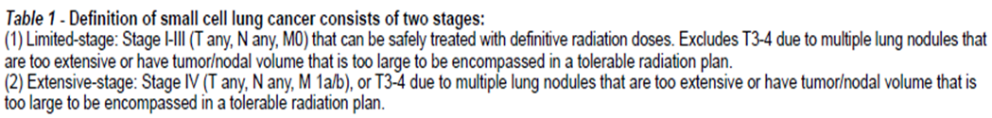
2017
● SCLC Staging? Limited vs. extensive stage怎麼區分?
● Limited stage thoracic RT怎麼做? BID or QD 的dose分別怎麼給? 什麼時候做PCI? 劑量給多少? 為什麼dose不給高一點?
A: 45Gy BID INT 0096, or Convert 60Gy QD, CalGB 30611 testing 45gy bid vs 70gy
A: limited stage , Post-OP all PCI, (stage i-IIA may omit),
RTOG 0212 25Gy vs 36Gy, 36Gy decrease OS, Auperin metaanalysis, earlier PCI <4-6 months decrease risk in brain mets, WBRT neurotoxicity higher in >60, if poor KPS and cognition omit PCI
● Extensive stage 要不要做PCI or thoracic RT?
A: 老題目
OS benefit in EORTC Slotman any response to chemo 20Gy/5fx, no pre-Txbrain MRI
Japan Takahashi negative stage brain MRI, no benefit of pCI in extensive stage trend toward negative OS

Slide 40

2018
Q1: Locally advanced: 一個 lung mass case, chest CT 有看到 mediastinal LN，問候接下來要排什麼檢
查？治療方式? (是adenocarcinoma，記得要驗EGFR<- 這個據說沒講就醜一了)
A: arrange PET/ CT, PFT (if not previously done), Brain MRI
Q2: . Early stage: 一個 lung cancer T2N0 的
i. 治療建議？
A: OP, or SBRT if inoperable
ii. 如果這個病人拒絕開刀那能不能SBRT？ 可
iii. 如果不能biopsy, 可不可以SBRT?
NCCN: nonsurgical require histologic confirmation. RoSEL trial accepted patients without biopsy, most trials required biopsy prove such as RTOG 0236
iv. SBRT 的預後？ Grade 3-5 toxicity depend on Location and tumor size
Locaton: 46% hilar, vs 17% perihilar, Size GTV> 10cc 8x risk of grade 3-5 toxicity Timmerman 2006
c. Extensive stage small cell lung cancer 要不要 PCI？
NCCN CR or partial response→ PCI, (EORTC Slotman)
d. RT 的 prescription and OAR constraint?
Spinal cord, heart, lung, esophagus, brachial plexus

Slide 41
2018
Q: SBRT 的預後？
SBRT operable不輸給 OP: Pooled analysis of STARS/Rosel 發現 OS比較好 3 year 95%, lower toxicity 10%
SEER JAMA 2014 Shirvani, no difference between SBRT and OP
>70 more mortality with surgery
Q: Extensive stage small cell lung cancer 要不要 PCI？
NCCN CR or partial response (PCI + Thoraci RT)
EORTC Slotman any response PCI improve OS , Japanese trial extensive stage PCI trend to detriment

Slide 42
2018
Q: 呼吸調控的方式 ABC 跟 gating 差在哪裡？
A:
A: Respiratory gating (a) phase gating: beam on when respirator signal within gating window defined by respiratory signal
(b) amplitude gating: beam on when respiratory signal is within gating window defined based on amplitude/ displacement of respiratory signal
ANZAI respiratory gating system (measuring abdominal pressure),
Varian RPM, (measuring chest wall motion by optic system with infrared camera or laser surface imaging)
Elekta ABC system (measuring the inspiration and expiration air volume using spirometry or temperature change)

Slide 43
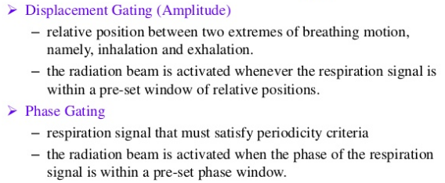
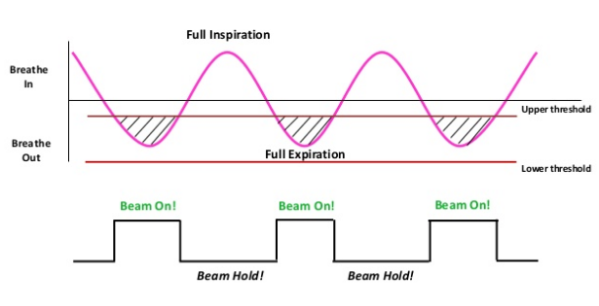
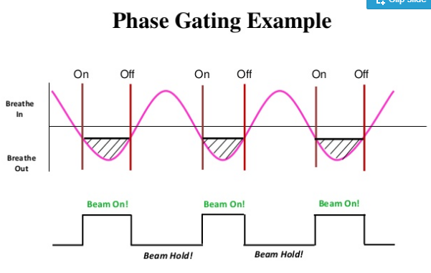


Slide 44
